Slide 1
Ancillary firmware for the NSW Trigger Processor
Lorne Levinson, for the
NSW Trigger Processor Working Group
NSW Electronics Design Reviews, February 2015

Slide 2
Ancillary functions
Several firmware modules support the algorithms and interface to the external IO.
These functions are common to both MM and sTGC. Their firmware can be shared as well-defined packages.
Excludes the input links:
MM receives from a GBTx transmitter
sTGC receives from an FPGA transmitter
Includes
timing and trigger control (TTC)
Level-1 pipeline and derandomizer
read/write of configuration parameters
monitoring
playback for debugging
Segment output to Sector Logic
Segment output to “other” detector’s trigger processor

Slide 3
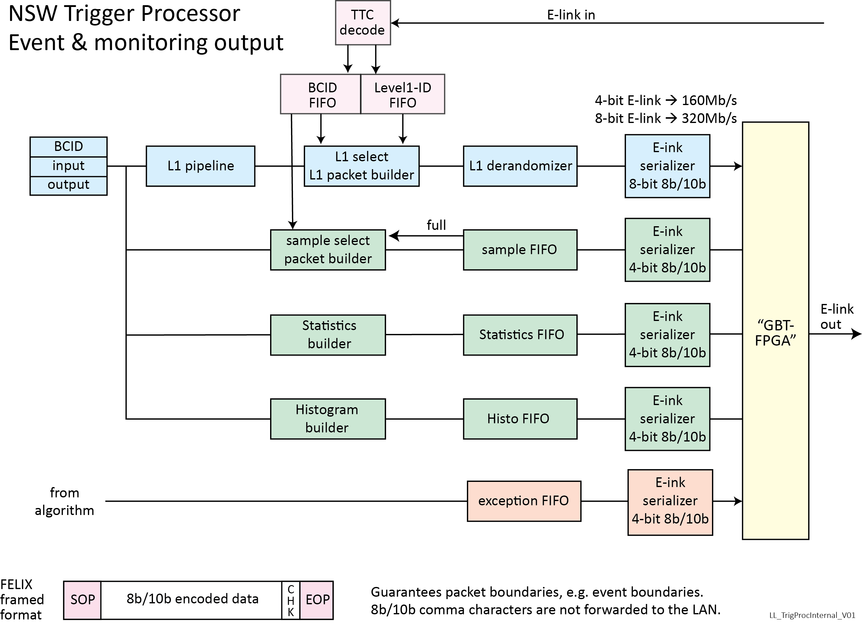

Slide 4
Routing of logical data streams
For simplicity, all the IO streams (except the found segments) aretransfered via E-links on a single GBT link connected to FELIX.
FELIX then routes the various logical data streams to the appropriate network end-points.
Interfacing the streams to the GBT protocol as E-links is extremely simple, much simpler than Ethernet TCP-IP.
FELIX then translates to standard ethernet to allow communicating with processes on PCs.

Slide 5
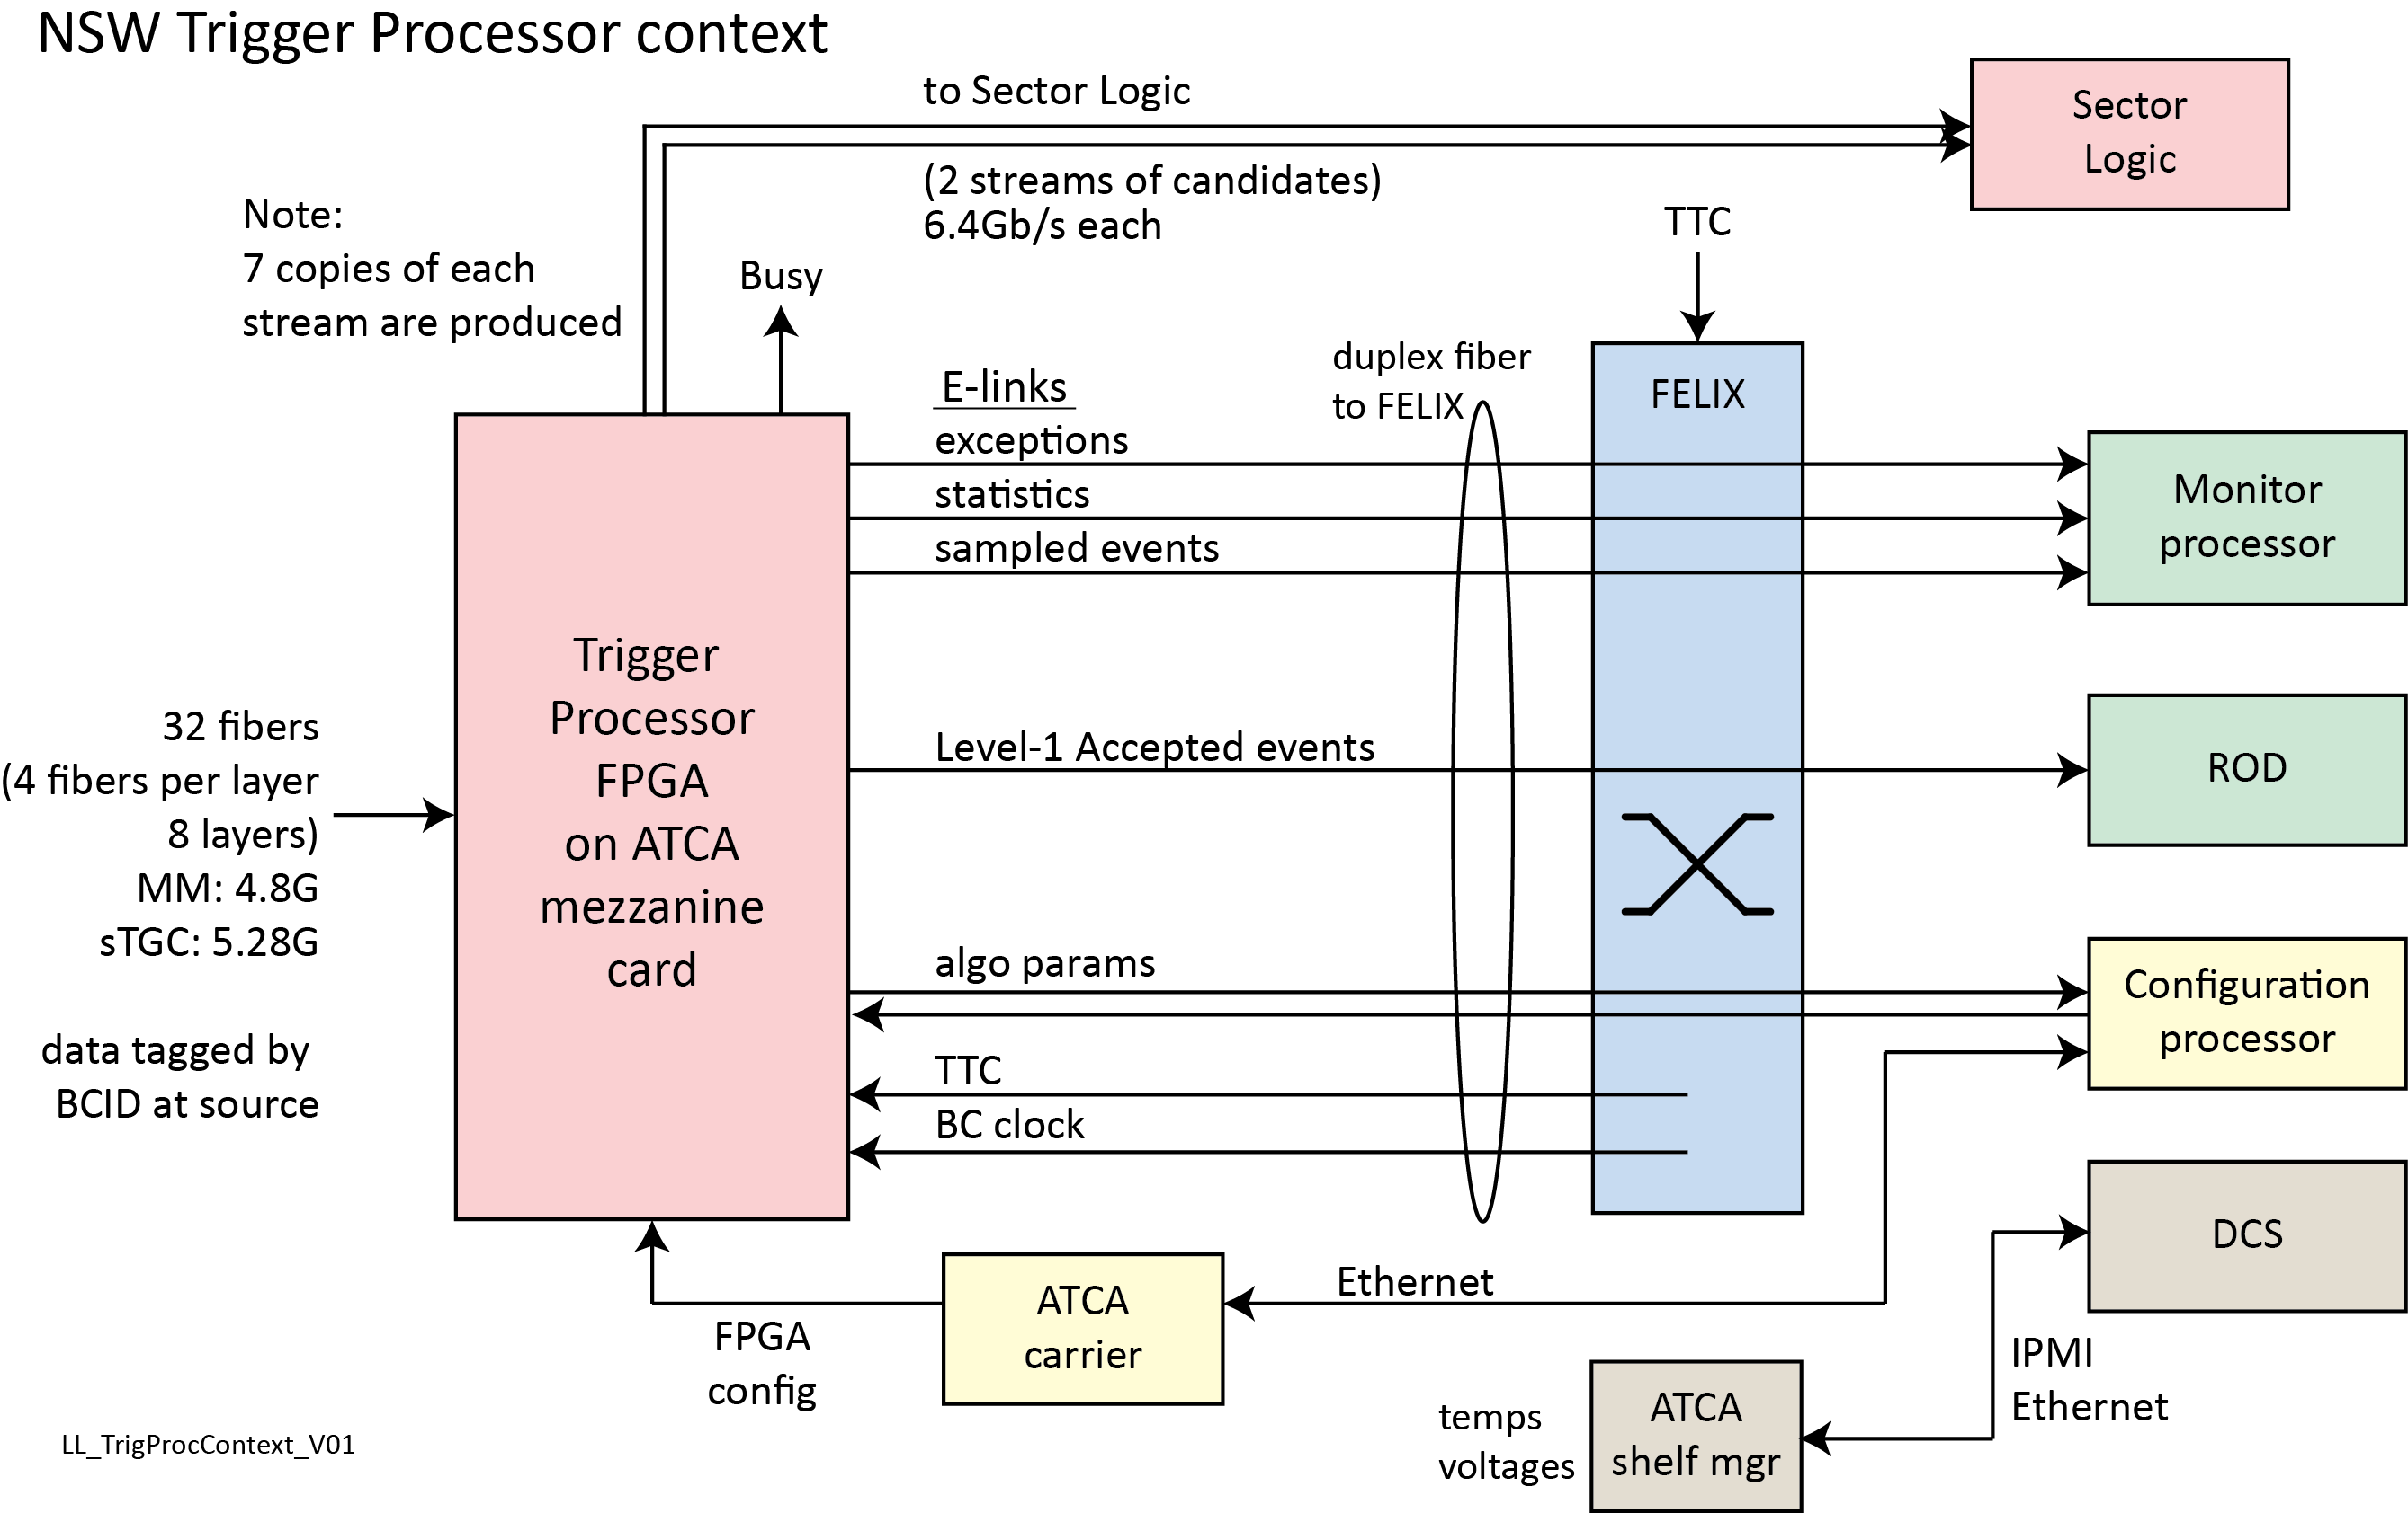

Slide 6
TTC E-link
FELIX injects TTC data into an E-link
FELIX Phase 1 options with legacy TTC
E-link width | bit 0 | bit 1 | bit 2 | bit 3 | bit 4 | bit 5 | bit 6 | bit 7
2 bits | A-chan | B-chan
4 bits | L1A | BCR | ECR | user or B-chan
8 bits | L1A | BCR | ECR | user or B-chan | user | user | user | user
 |  | example: |  | test pulse | reset
Phase 2: TTC via FELIX formats to be decided by FELIX and TTC groups
Possible for Phase 2:
L1A → L0A; ECR → L0ECR
B-chan must transmit BCID of L1A recall: L1-Accept will not have fixed latency could use bits[7..4] for a wider B-chan
From 40MHz BC E-link clock, ePLL generate clocks for the 80, 160, 320Mb/s E-links and 160MHz design clock

Slide 7
Level-1 output buffer
For bunch-crossings in which at least one segment is found:
store the input data and the output segment data in a FIFO
along with its BCID for later matching to the BCID of a Level-1 Accept.
Those bunch-crossings that have Level-1 Accepts (and possibly those preceding and following) are transferred to the Level-1 output buffer (aka derandomizer).
The data must be stored for the duration of the Level-1 latency.
The output bandwidth should be sufficient for the rather small fixed input and output data lengths at the full Level-1 rate of 400kHz.
Event packets are routed by FELIX to the ROD.
This logic could provide a BUSY output to the RODBUSY system when its output buffer becomes close to full.

Slide 8
Monitored event buffer
A random sample of complete events are collected for sending to a monitoring process, e.g.:
any event,
event with at least one segment found
events with segments outside the Δθ cut
The data buffered as one event includes:
all the input data
the output segment data that is sent to the Sector Logic
within the BC window (1 to 8 BCs).
Event packets for monitoring are routed by FELIX to the Monitor PC.

Slide 9
Statistics and Exception buffers
Statistics are continuously collected and periodically transferred to the Statistics buffer, e.g.:
number of bunch-crossings that have candidates that are not accepted by Level-1, and their distribution in Rφ,
the multiplicity of segments per bunch-crossing
In the course of processing, exceptional conditions may be found, usually due to corrupted data. A convenient way to handle these is to store an exception code and some context data into a buffer which will be passed to the monitoring PC via FELIX.
Statistics and Exception packets are routed by FELIX to the Monitor PC.

Slide 10
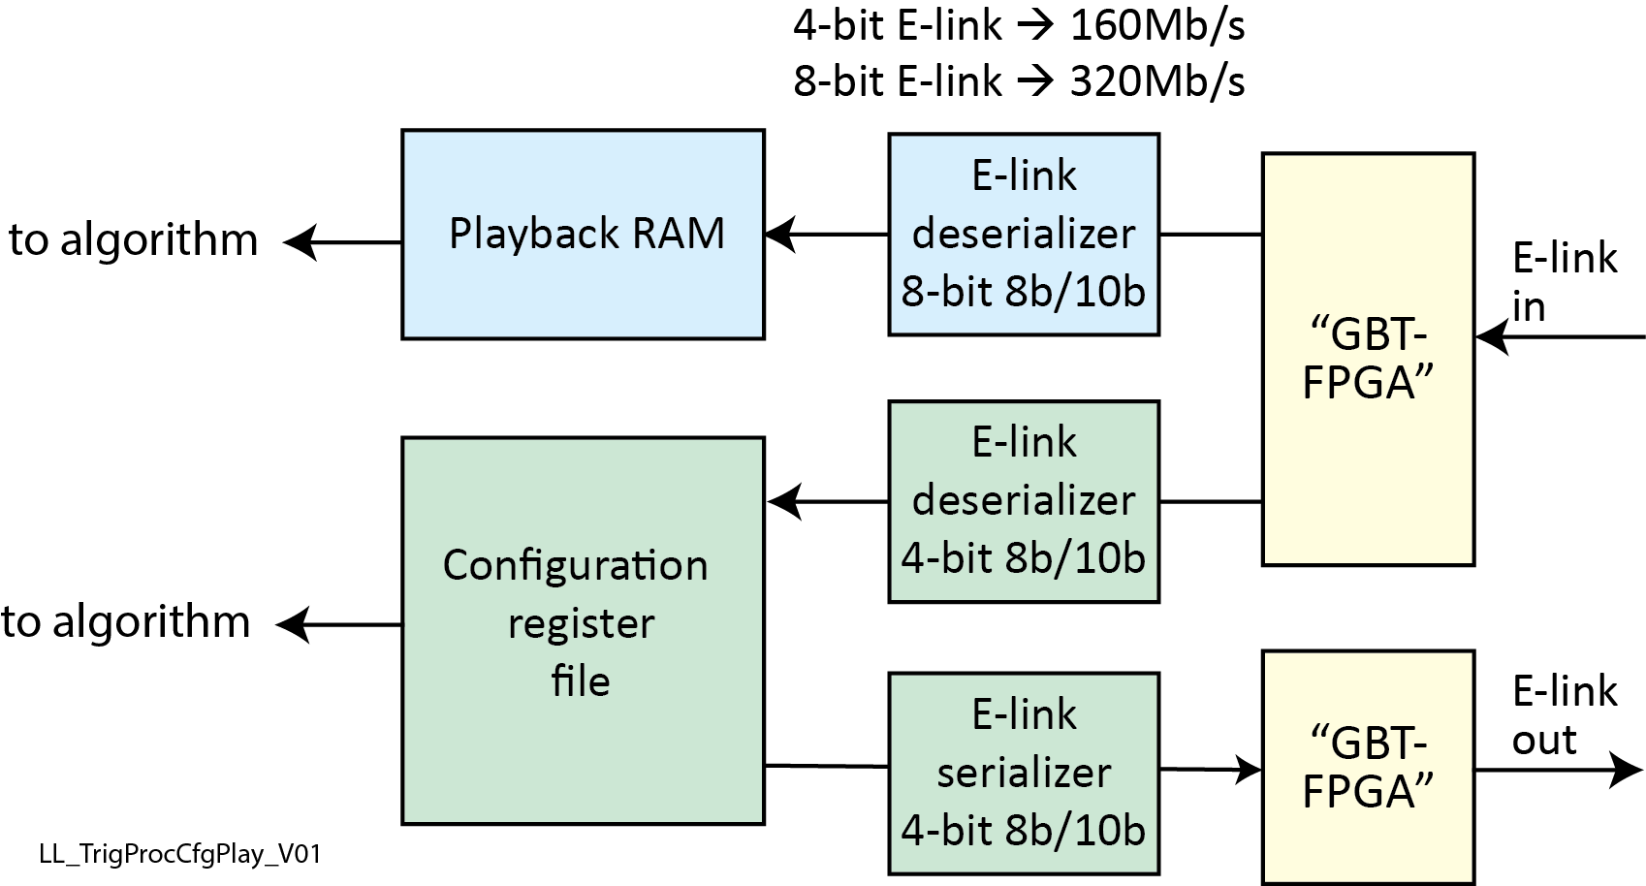
Configuration, playback
Parameters for the algorithms must be stored at runtime, e.g.:
Δθ cut and other cuts
BCID offset
Alignment parameters
the parts of the detector to be considered as disabled
road size, etc.
Read-back of the parameters must also be provided.
For development and testing we require that simulated data can be injected in place of the data received by the links to the Front End.
This allows full-speed testing.
Configuration packets are routed by FELIX to/from the configuration PC.

Slide 11
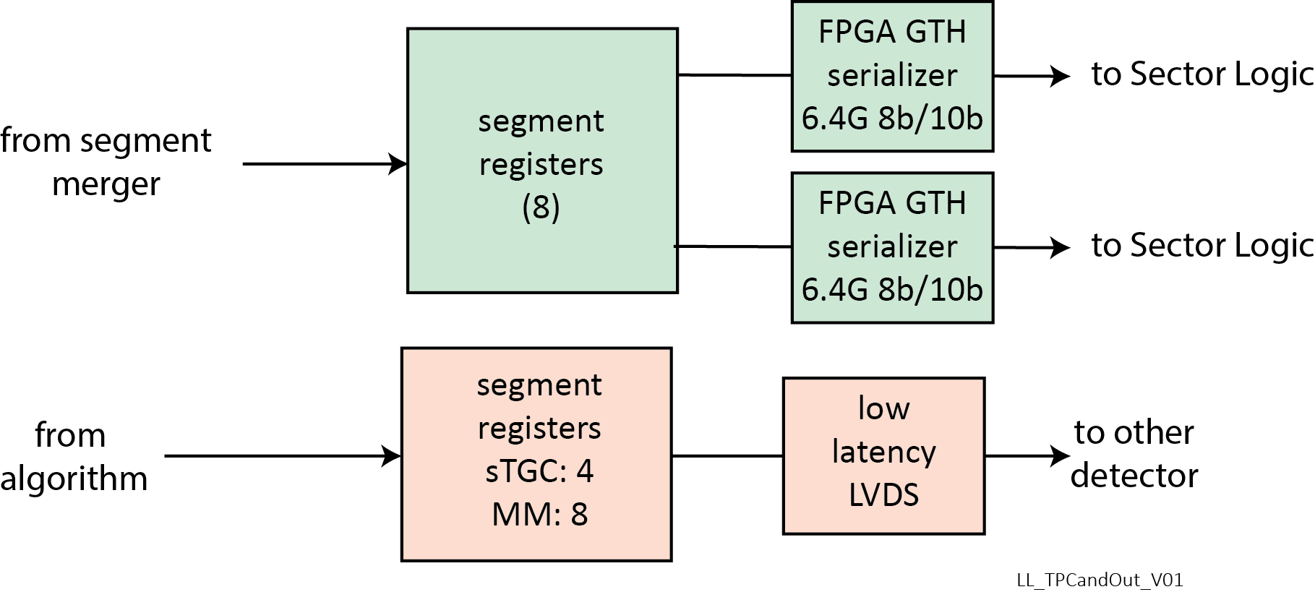
Segment output
Segments are sent out either to the Sector Logic via the FPGA serialize, or to the ``other'' detector via a parallel low latency LVDS bus.
If the segments found are to be sent to the ``other'' detector's Trigger Processor, the segment data must be sequenced out onto the parallel LVDS bus.
Clones must be made and the output links to the Sector logic must be driven.

Slide 12
TTC E-link
FELIX injects TTC data into an E-link
FELIX Phase 1 options with legacy TTC
E-link width | bit 0 | bit 1 | bit 2 | bit 3 | bit 4 | bit 5 | bit 6 | bit 7
2 bits | A-chan | B-chan
4 bits | L1A | BCR | ECR | user or B-chan
8 bits | L1A | BCR | ECR | user or B-chan | user | user | user | user
 |  | example: |  | test pulse | reset
Phase 2: TTC via FELIX formats to be decided by FELIX and TTC groups
Possible for Phase 2:
L1A → L0A
B-chan must transmit BCID of L1A recall: L1-Accept will not have fixed latency could use bits[7..4] for a wider B-chan
From 40MHz BC E-link clock, ePLL generate clocks for the 80, 160, 320Mb/s E-links and 160MHz design clock

Slide 13
Configuration parameters
ROC configuration parameters
ROC ID
BCoffset
Size of trigger window (which neighboring BCs to read out on a Level-1 Accept)
Select either the L1A or the L0A signal as the “L0A” signal sent to VMMs.
For each VMM input: enable and mapping to SROC/E-link
SROC output enables E-link speeds: 80, 160 or 320Mb/s
Enable transmission of BUSY symbols
New VMM configuration parameters
Level-0 latency (BCs)
Size of trigger window

Slide 14
Methodology
Three groups will participate in writing the firmware:
Harvard
Illinois
Weizmann
Repository of HDL source in SVN
Designs are built by scripts that extract the needed modules from the repository.
FELIX prototype firmware will be used to drive the fiber inputs and outputs.
FELIX firmware can run on the same FPGA as used for prototyping the Trigger Processor, in loop back mode, or, in a separate FPGA board.
(Weizmann is one of the FELIX developers.)

Slide 15
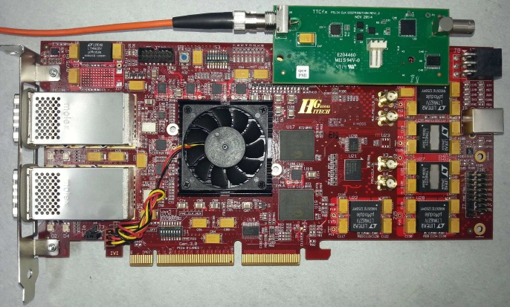
Platform for prototyping firmware
Global HiTech HTGC-710, shown
Virtex X690T
2x12 bidir links
TTC FMC: with CDR,
jitter cleaner, Busy out
Also:
Xilinx VC709
Virtex X690T
4 bidir links

Slide 16
Thank you

